Slide 1
Logistic Regression
Logistic regression is a supervised machine learning algorithm used for classification tasks

Slide 2
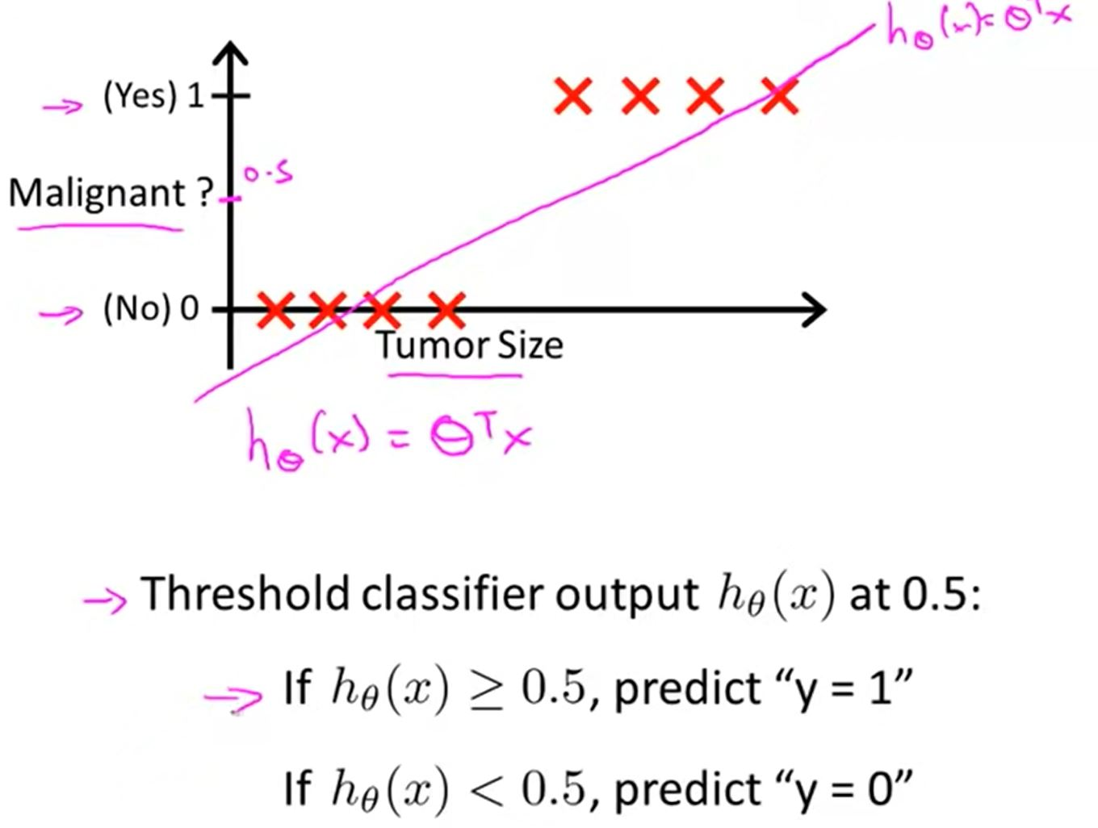
Linear Regression for Classification Problem
$h_{θ}\left(x\right)=\tilde{y}(x)$
Decision boundary: a line (in the case of two features), where all (or most) samples of one class are on one side of that line, and all samples of the other class are on the opposite side of the line.
The line separates one class from the other.
For more than two features, the decision boundary is not a line, but a (hyper)-plane
Binary Classification Problem: Classify Malignant/benign cells from its size
All the values lie to its left side are considered as a negative class and all the values lie to its right side are positive class
Negative class
Positive class

Slide 3
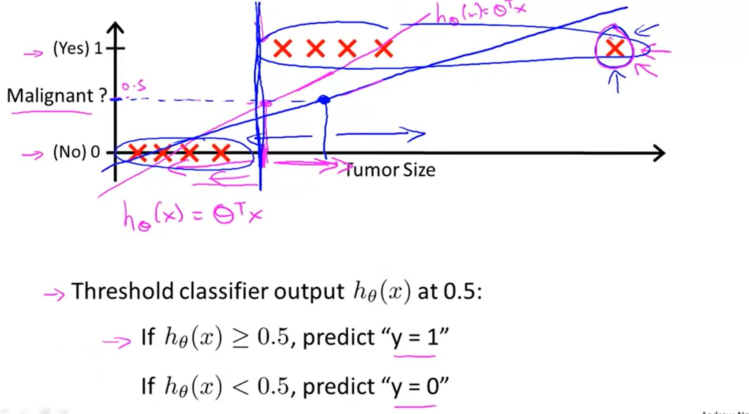
Linear Regression for Classification Problem: Outliers
Linear Regression is highly affected by the inclusion of an outlier
$h_{θ}\left(x\right)=\tilde{y}(x)$
New Decision boundary due the inclusion of an outlier

Slide 4
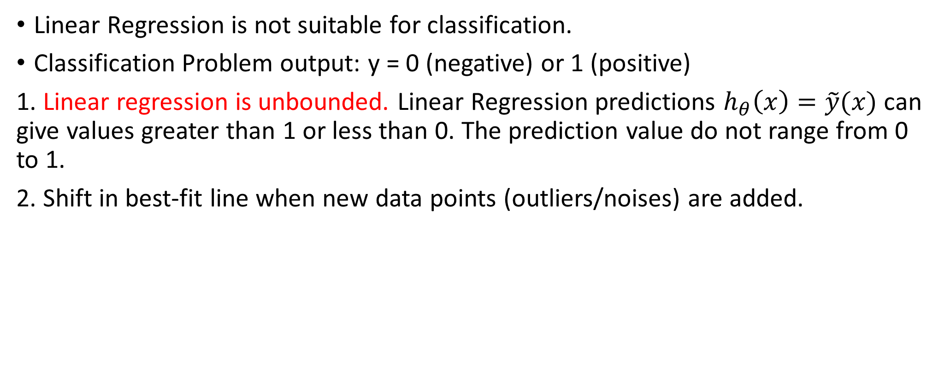
Why Linear Regression fail for Classification Problem
Linear Regression is not suitable for classification.
Classification Problem output: y = 0 (negative) or 1 (positive)
1. Linear regression is unbounded. Linear Regression predictions $h_{θ}\left(x\right)=\tilde{y}(x)$ can give values greater than 1 or less than 0. The prediction value do not range from 0 to 1.
2. Shift in best-fit line when new data points (outliers/noises) are added.

Slide 5
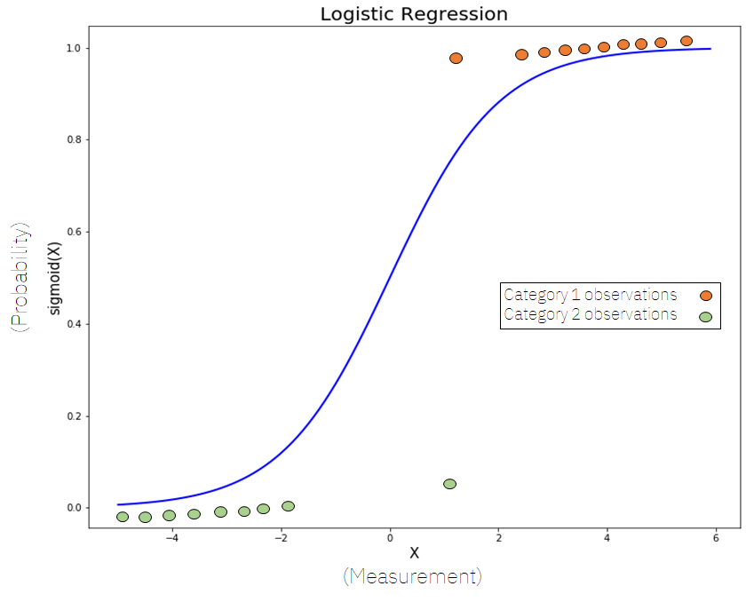
Logistic Regression for Classification Problem
Used for the classification problems,
Predictive analysis algorithm and based on the concept of probability.
Cost function can be defined as the S-shaped ‘Sigmoid function’ or also known as the ‘logistic function’
The function maps any real value between 0 and 1
The hypothesis of logistic regression tends it to limit the cost function between 0 and 1
Named ‘Logistic Regression’
underlying technique is quite the same as
Linear Regression.
The term “Logistic” is taken from the
Logit function that is used in this method of classification

Slide 6
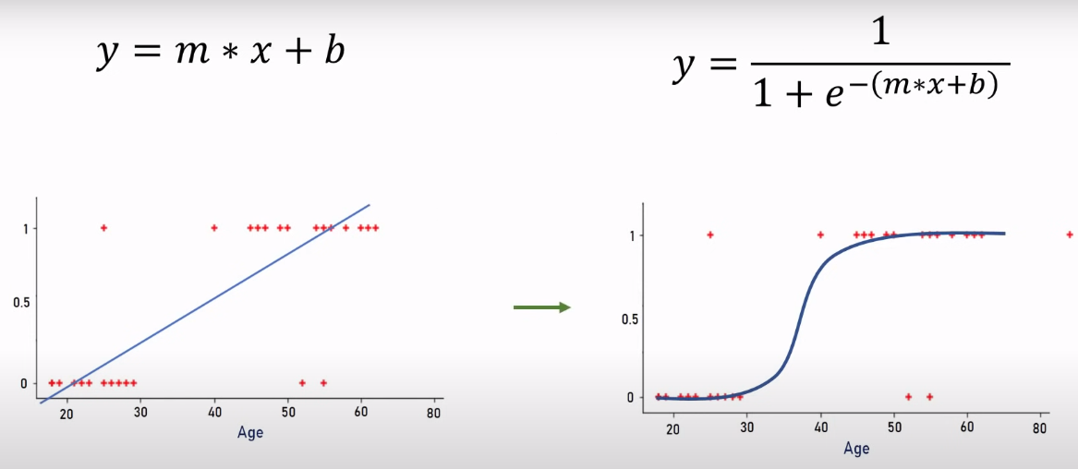
Logistic Regression
Data is fitted into linear regression model, which then be transformed to a logistic function predicting the target categorical dependent variable
After transformation, we will get a line that remains between 0 and 1.
All the continuous values we will get will be between 0 and 1 which we can use as a probability for making predictions. For example, if the predicted value is on the extreme right, the probability will be close to 1 and if the predicted value is on the extreme left, the probability will be close to 0
When the result of the sigmoid function is greater than 0.5, we classify the label as class 1 or positive class; if it’s less than 0.5, we can classify it as a negative class or 0

Slide 7
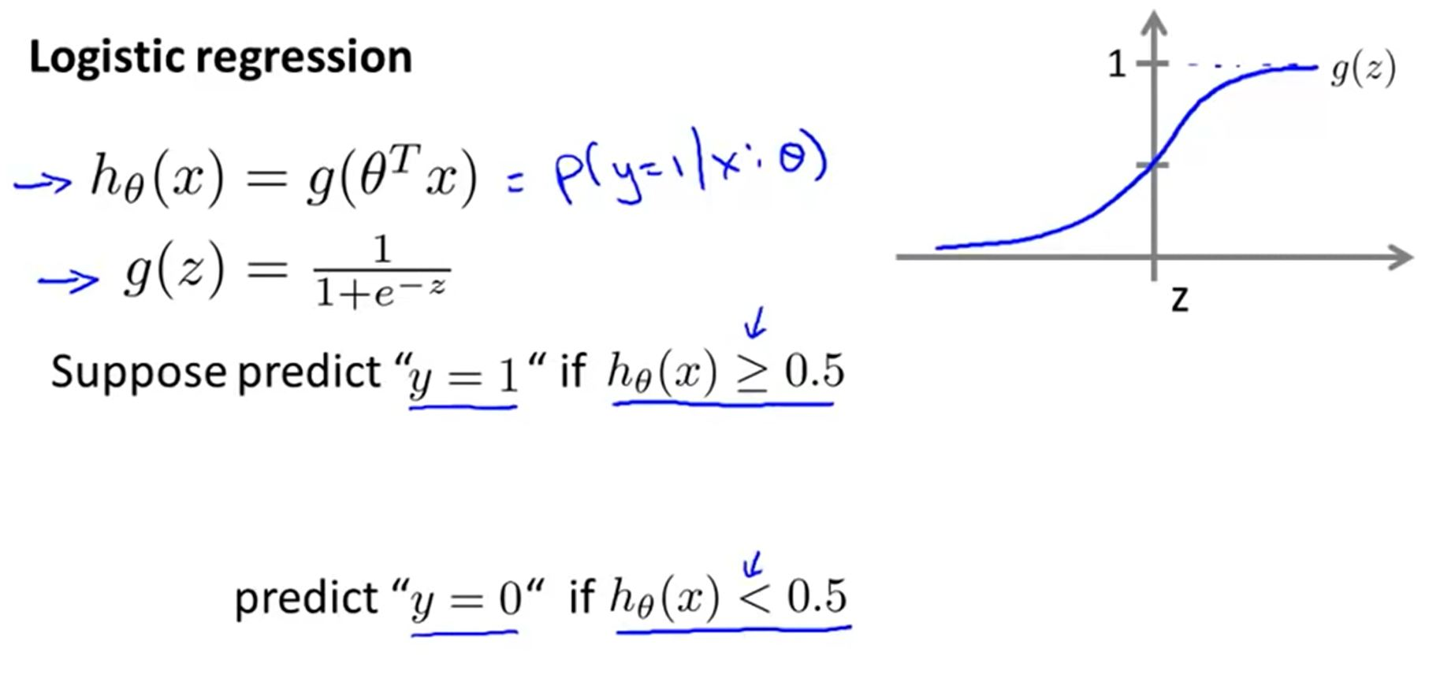
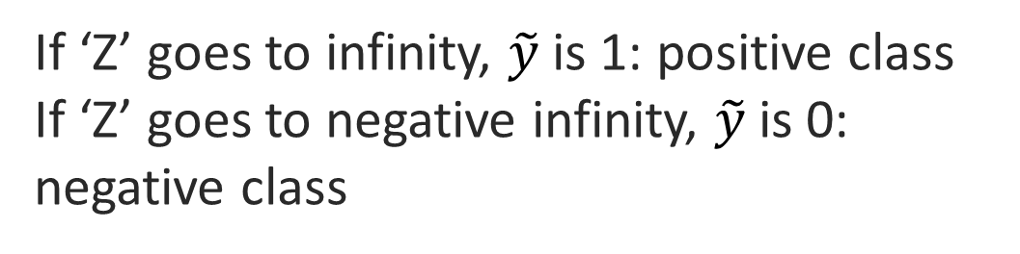
Logistic Regression for Classification Problem
If ‘Z’ goes to infinity, $\tilde{y}$is 1: positive class
If ‘Z’ goes to negative infinity, $\tilde{y}$is 0: negative class

Slide 8
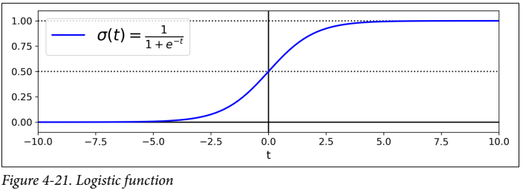
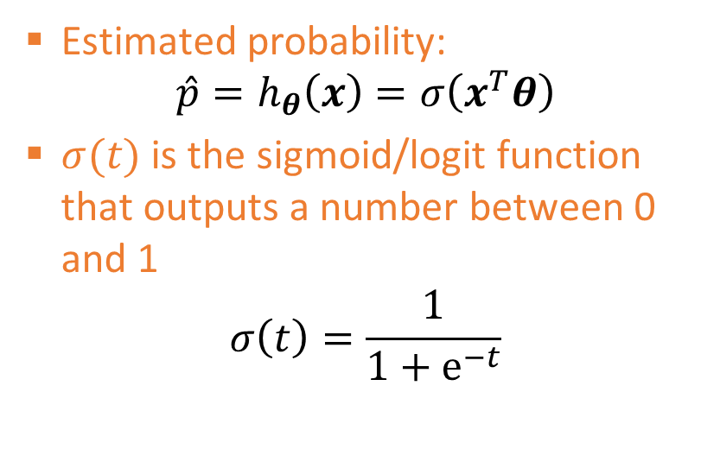

Logistic Regression
Binary classifier- also called Logit Regression, but used in classification tasks
The probability that an instance belongs to a particular class is estimated
If estimated probability is more than 50%, the model predicts the instance to belong to that class – otherwise, it predicts it does not belong to that class
Estimated probability:
$$\hat{p}=h_{θ}\left(x\right)=σ\left(x^{T}θ\right)$$
$σ(t)$ is the sigmoid/logit function that outputs a number between 0 and 1
$$σ\left(t\right)=\frac{1}{1+ⅇ^{−t}}$$
$$\hat{y}=\left\{\begin{aligned}0 if\hat{p}<0.5 \\ 1 if \hat{p}≥0.5\end{aligned} \right.$$

Slide 9
Linear Regression vs. Logistic Regression
Linear Regression is used to handle regression problems whereas Logistic regression is used to handle the classification problems.
Linear regression provides a continuous output, but Logistic regression provides discrete output.
The purpose of Linear Regression is to find the best-fitted line while Logistic regression fits the line values to the sigmoid curve.
The method for calculating loss function in linear regression is the mean squared error whereas for logistic regression it is maximum likelihood estimation

Slide 10
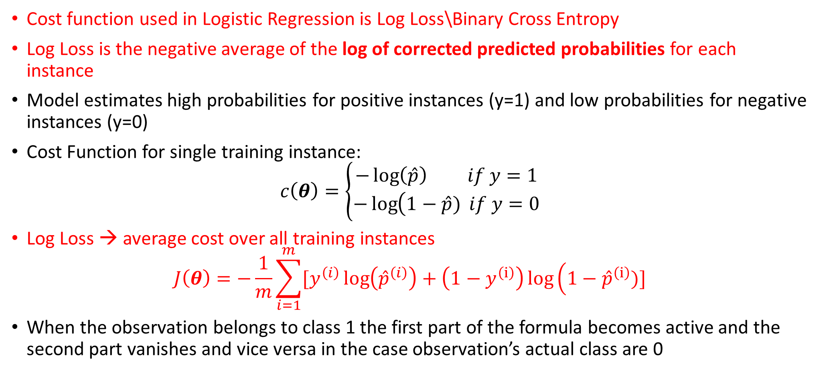
Logistic Regression Cost Function
Cost function used in Logistic Regression is Log Loss\Binary Cross Entropy
Log Loss is the negative average of the log of corrected predicted probabilities for each instance
Model estimates high probabilities for positive instances (y=1) and low probabilities for negative instances (y=0)
Cost Function for single training instance:
$$c\left(θ\right)=\left\{\begin{matrix}−\log\left(\hat{p}\right) if y=1 \\ −\log\left(1−\hat{p}\right.) if y=0\end{matrix}\right.$$
Log Loss → average cost over all training instances
$$J\left(θ\right)=−\frac{1}{m}\sum_{i=1}^{m}{[y^{\left(i\right)}\log\left({\hat{p}}^{\left(i\right)}\right)}+\left(1−y^{\left(ⅈ\right)}\right)\log\left(1−{\hat{p}}^{\left(ⅈ\right)}\right.)]$$
When the observation belongs to class 1 the first part of the formula becomes active and the second part vanishes and vice versa in the case observation’s actual class are 0

Slide 11
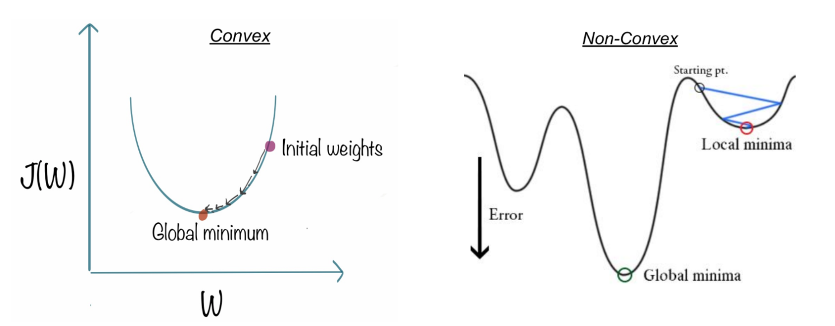
Why Log Loss
Linear Regression sum-squared-error cost function gives non-convex function with many local minimums for Logistic Regression
Convex type cost function always guarantees a global minimum, whereas a non-convex type only guarantees local minima

Slide 12
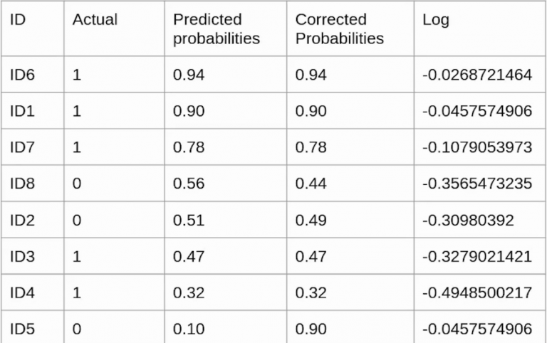
Why Log Loss
Actual: It is the class the sample originally belongs to.
Predicted_probabilities.: The is output given by the logistic regression model
ID6 originally belongs to class 1 hence its predicted probability and corrected probability is the same i.e., 0.94
ID8 originally belongs to actual class 0, but predicted 1, hence its predicted probability and corrected probability are NOT same
The reason behind using the log value is, the log value offers less penalty for small differences between predicted probability and corrected probability. when the difference is large the penalty will be higher

Slide 13
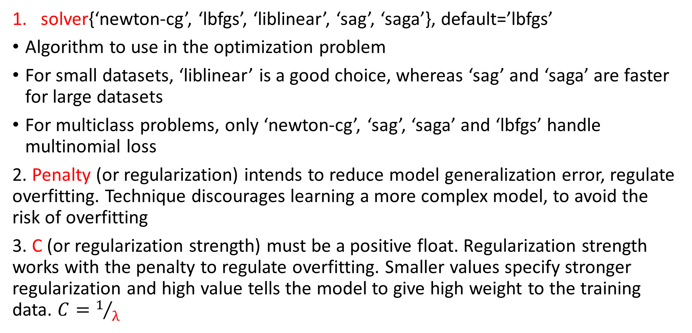
Logistic Regression Hyperparameters
solver{‘newton-cg’, ‘lbfgs’, ‘liblinear’, ‘sag’, ‘saga’}, default=’lbfgs’
Algorithm to use in the optimization problem
For small datasets, ‘liblinear’ is a good choice, whereas ‘sag’ and ‘saga’ are faster for large datasets
For multiclass problems, only ‘newton-cg’, ‘sag’, ‘saga’ and ‘lbfgs’ handle multinomial loss
2. Penalty (or regularization) intends to reduce model generalization error, regulate overfitting. Technique discourages learning a more complex model, to avoid the risk of overfitting
3. C (or regularization strength) must be a positive float. Regularization strength works with the penalty to regulate overfitting. Smaller values specify stronger regularization and high value tells the model to give high weight to the training data. $C=1/λ$

Slide 14
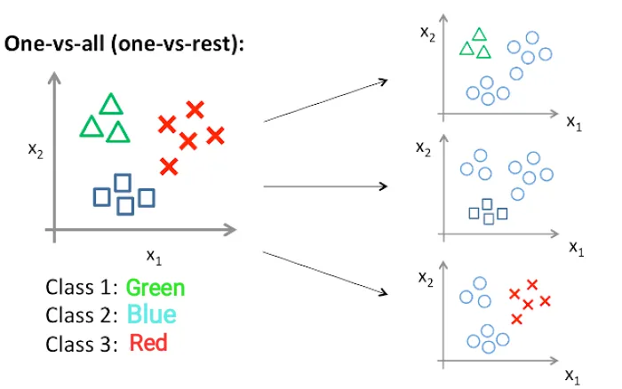
Multiclassification Problem (OVR/OVA): Multinomial Logistic Regression
One-vs-rest (OvR)/ One-vs-All (OvA): uses binary classification algorithms for multi-class classification.
It involves splitting the multi-class dataset into multiple binary classification problems. A binary classifier is then trained on each binary classification problem and predictions are made using the model that is the most confident/highest probability.
Sklearn: LogisticRegression(multi_class='ovr')
Sklearn: OneVsRestClassifier
Binary Classification Problem 1: green vs. rest
Binary Classification Problem 2: red vs. rest
Binary Classification Problem 4: blue vs. rest

Slide 15
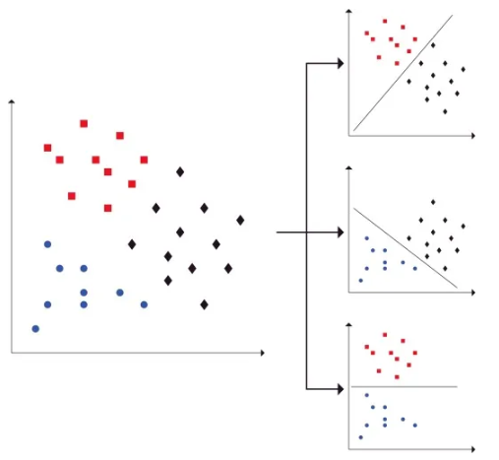
Multiclassification Problem (OVO)
One-vs-one (OvO) splits a multi-class classification dataset into multiple binary classification problems. Unlike one-vs-rest that splits it into one binary dataset for each class, the one-vs-one approach splits the dataset into one dataset for each class versus every other class.
For example, consider a multi-class classification problem with four classes: ‘red,’ ‘blue,’ and ‘black.’ This could be divided into three binary classification datasets as follows:
Binary Classification Problem 1: red vs. blue
Binary Classification Problem 2: red vs. black
Binary Classification Problem 3: blue vs. black
Each binary classifier predicts one class label.
When we input the test data to the classifier,
then the model with the majority counts is
concluded as the prediction

Slide 16
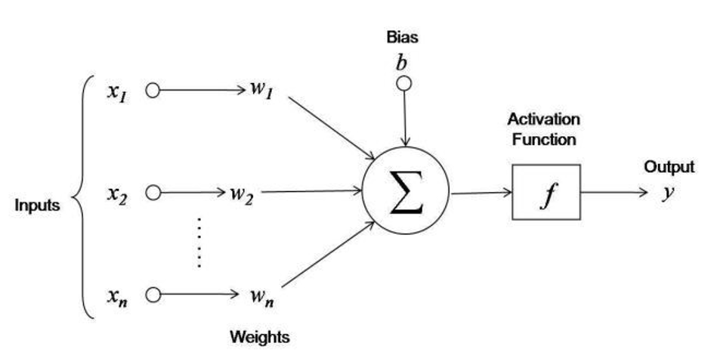
Activation/Transfer Function
In Deep Learning/neural network: An Activation Function decides whether a neuron should be activated/fired/transferred or not
This means that it will decide whether the neuron’s input to the network is important or not in the process of prediction
Activation Function is used in the hidden layer as well as at the output layer of the network
Primary role: transform the summed input + bias from the node into an output value to be fed to the next hidden layer or as output
Purpose of an activation function is to add non-linearity to the neural network

Slide 17
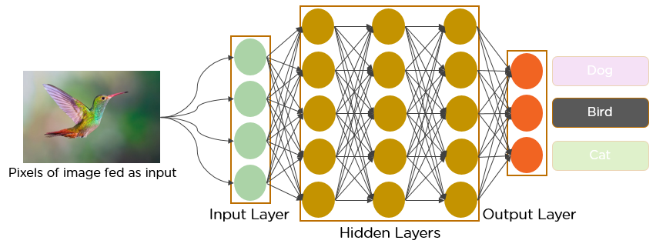
Activation/Transfer Function
Input Layer: This layer accepts input features/image/data. It provides information from the outside world to the network, no computation is performed at this layer, nodes here just pass on the information (features) to the hidden layer.
Hidden Layer: Nodes of this layer are not exposed to the outer world, they are part of the abstraction provided by any neural network. The hidden layer performs all sorts of computation (convolution, pooling, normalization, dropping) on the features entered through the input layer and transfers the result to the output layer
Backpropagation aims to minimize the cost function by adjusting the network’s weights and biases

Slide 18
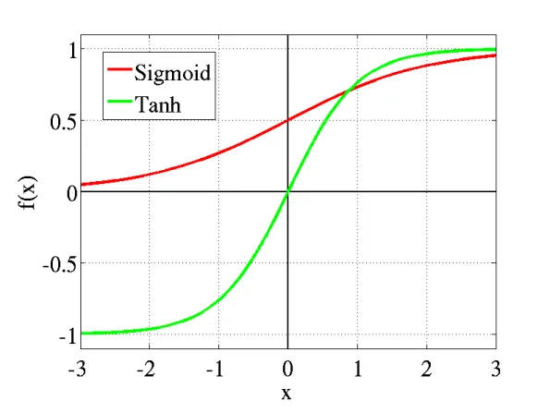
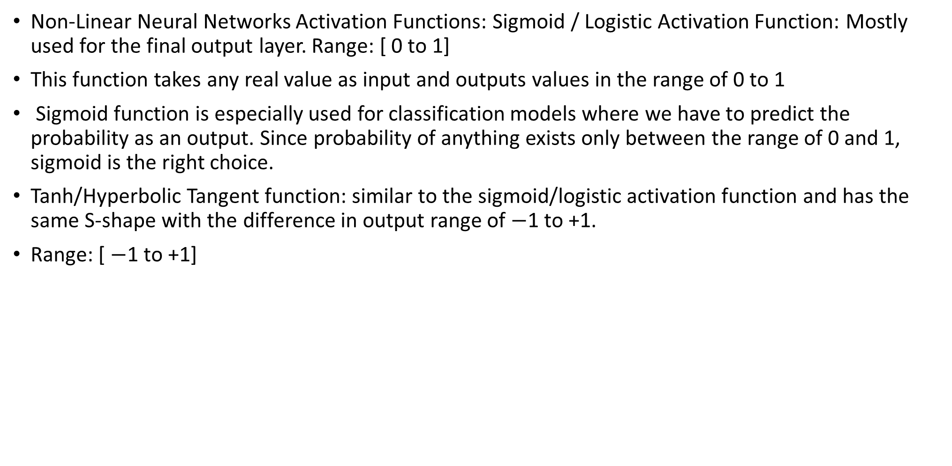
Activation/Transfer Function
Non-Linear Neural Networks Activation Functions: Sigmoid / Logistic Activation Function: Mostly used for the final output layer. Range: [ 0 to 1]
This function takes any real value as input and outputs values in the range of 0 to 1
Sigmoid function is especially used for classification models where we have to predict the probability as an output. Since probability of anything exists only between the range of 0 and 1, sigmoid is the right choice.
Tanh/Hyperbolic Tangent function: similar to the sigmoid/logistic activation function and has the same S-shape with the difference in output range of $−$1 to +1.
Range: [ $−$1 to +1]

Slide 19
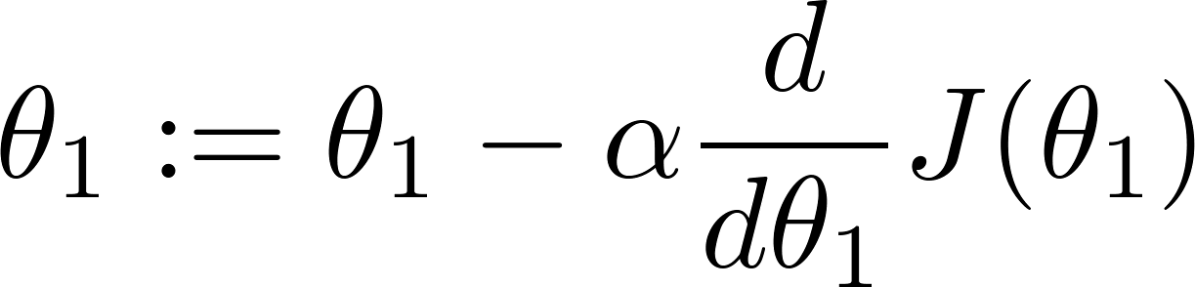
Vanishing gradient problem
The use of sigmoid function restricted the training of deep neural networks because it caused the vanishing gradient problem. This caused the neural network to learn at a slower pace or in some cases no learning at all
The gradient will be vanishingly small, effectively preventing the weight from changing its value
Vanishing GD: Low gradient leads to slow training: weights/parameters will change very slowly
Vanishing gradients make it difficult to know which direction the parameters should move to improve the cost function
Exploding GD: Large gradient leads to fast training: weights/parameters will change very fast/explode

Slide 20
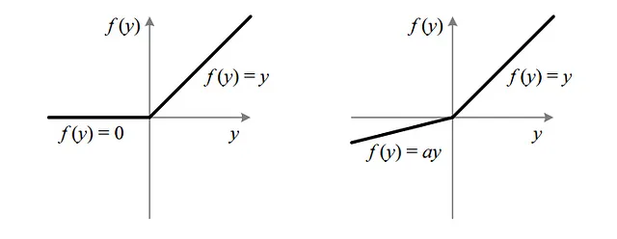
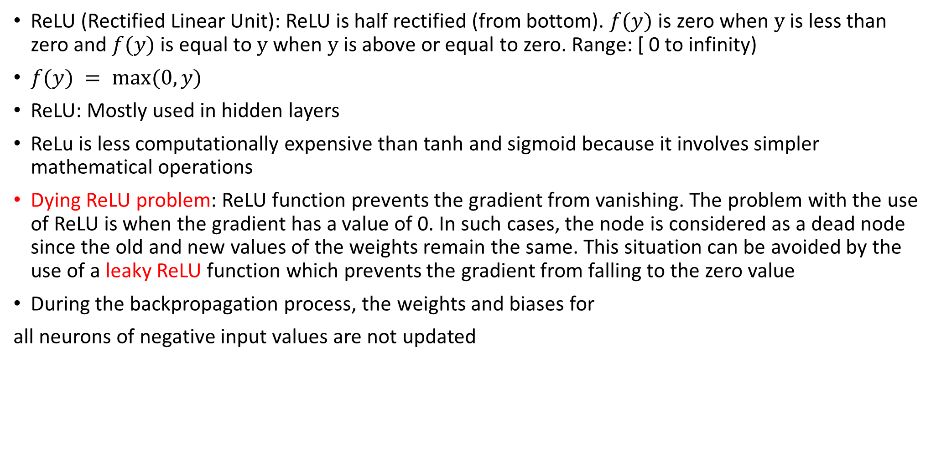
Activation/Transfer Function: ReLU
ReLU (Rectified Linear Unit): ReLU is half rectified (from bottom). $f(y)$ is zero when $y$ is less than zero and $f(y)$ is equal to $y$ when $y$ is above or equal to zero. Range: [ 0 to infinity)
$f(y) = max⁡(0,y)$
ReLU: Mostly used in hidden layers
ReLu is less computationally expensive than tanh and sigmoid because it involves simpler mathematical operations
Dying ReLU problem: ReLU function prevents the gradient from vanishing. The problem with the use of ReLU is when the gradient has a value of 0. In such cases, the node is considered as a dead node since the old and new values of the weights remain the same. This situation can be avoided by the use of a leaky ReLU function which prevents the gradient from falling to the zero value
During the backpropagation process, the weights and biases for
all neurons of negative input values are not updated

Slide 21

Activation/Transfer Function: Leaky ReLU
Leaky ReLU is an improved version of ReLU function to solve the Dying ReLU problem as it has a small positive slope in the negative area.
Leaky ReLU: $f(y) = max⁡(0.1×y,y)$
It does enable backpropagation, even for negative input values
Parametric Leaky ReLU: $f(y) = max⁡(a×y,y)$
$a$ is the slope parameter for negative values

